Slide 1


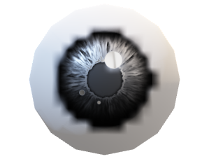
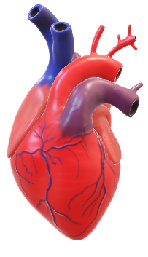
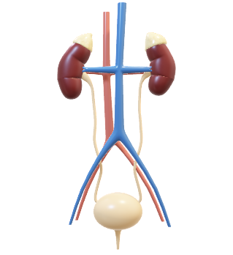
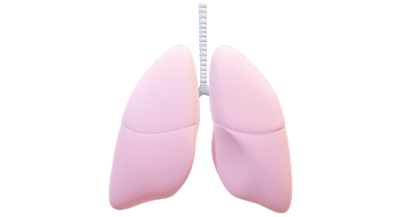
The organ alliance by:1NH21CS016

Slide 2

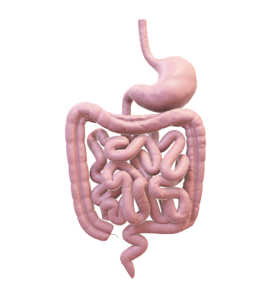
objectivees
Organ Alliance is a portal in which it gives details organ donor and its availability.
With reference to our present times, we sometime come across a situation where we need organ.
In such emergency conditions organ donor The database becomes really handy.
It stores name, age, phone number, address, email id and blood group of the Donor’s and which organ it there.
It is used for good cause and it tells “help someone after your death.

Slide 3
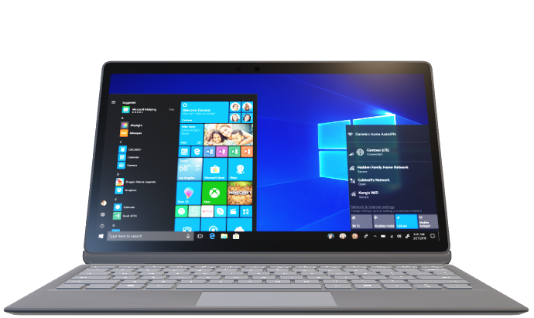
requirements
hardware
System Model : HP Laptop 15s-fq4xxx
Installed Physical Memory (RAM) : 8.00 GB
Processor : 11th Gen Intel(R) Core(TM) i5-1155G7 @ 2.50GHz, 2496 Mhz, 4 Core(s), 8 Logical Processor(s).
software
Os name : Microsoft windows 11
Installed Physical Memory (RAM) 8.00 GB
C language version

Slide 4
Road map
Search by hospital, id, organ
Get the donor card
Registration for organ donation

Slide 5
THE ORGAN
ALLIANCE
REGISTER
THE ORGAN
Search by hospital
Organ card
Enter the name, id,
Address
Phone no
Search by id
Search by organ

Slide 6
DESIGN
Step 1:Start
Step 2:Create a structure and declare the arrays.
Step 3:Store the data in file and display the dat
Step 4:Putting the pointeer at the end of the file.
Step 5:Close the file.
step 6:Display the menu option
step 7:Give choices using switch cases.
DESIGN

Slide 7
Step 8: Assign '1','2','3','4','5','6','7' to select the choice.
ep 9:Using if and else condition match the organ with the database.
Step 10:Display the choice.
Step 11:If any of given numbers from step 8 is typed it gives tehe following output.
Step 12:It will display register,search by hospital,donor Id,donor card,amount paid .
Step 13:After the end of each output you will be given option to continue or quit the program.

Slide 8
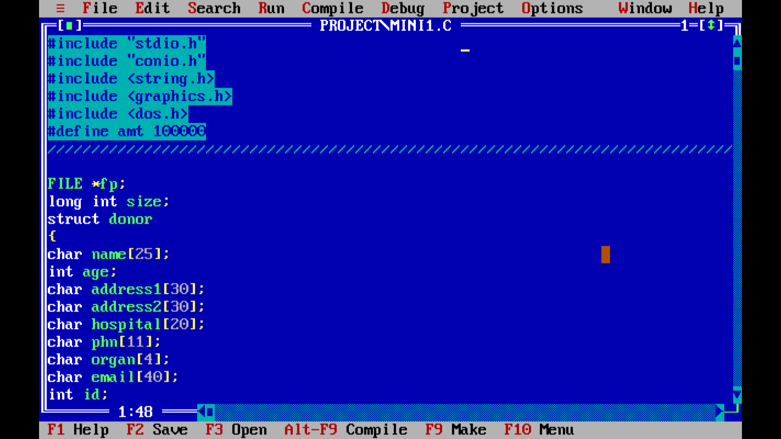
implementation
HHH * Create a structure.
* using array concept store values in the struct.
* use the pointer concept to store the values.
s

Slide 9
METHODOLOGY
HERE ARRAY COLLECTS OF ELEMENTS OF THE SAME TYPE PLACED IN CONTIGUOUS MEMORY LOCATIONS THAT CAN BE INDIVIDUALLY REFERENCED BY USING AN INDEX TO A UNIQUE IDENTIFIER FOR EXAMPLES NAME,ID,HOSPITAL.
AND THE SWITCH CASE evaluates a given expression and based on the evaluated value(matching a certain condition), it executes the statements associated with it. FOR EXAMPLE IF THE DONOR WANTS TO SEARCH THE ORGAN BY HOSPITAL,HE CAN DO SEARCH BY HOSPITAL.IF HE WANTS SEARCH BY DONOR ID ,HE CAN GO FOR SEARCH BY DONOR ID OPTION.
HERE File CONCEPT IS USED AS a collection of data stored in the secondary memory. So far data was entered into the programs through the keyboard.

Slide 10
So Files are used for storing information that can be processed by the programs. Files are not only used for storing the data, programs are also stored in files. SO HERE DONOTED ORGAN DETAILS ARE STORED IN FILES.
In this program the struct will store all the array with values. Store everything in file so that we can easily get the data whenever it is required.
Using the pointer end the file.
Using define header file assign the amount to be paid.
Using the while loop and statement generate the organ donor card.

Slide 11


thank you

